Slide 1
7) Cluster Analysis

Slide 2
Cluster analysis is a collection of techniques used to group objects in a way that members within a group are homogeneous, and dissimilar to objects in other clusters.
Uses Include:
-Market Segmentation
-New product development
-Portfolio creation
-Communication efficiencies

Slide 3
Example:
A beverage company is interested in identifying homogenous consumer groups based on attitudinal dimensions. Five attitudinal variables were included in the questionnaire and consumers asked to express their level of agreement on an 11 point scale (0=strongly disagree, 10=strongly agree)
X1=I try to drink healthy beverages
X2=I like to be considered a leader
X3=I’m usually one of the first to try new things
X4=I am very much aware of beverage prices
X5=You can tell a lot about a person by the beverages they drink

Slide 4
Example Data

Slide 5
Cluster Analysis Basics
Two dimensional example
I try to drink healthy beverages
S
S
S
S
S
S
S
S
S
S
S
S
S
S
S
S
S
S
S
S
S
S
S
S
S
S
t
t
t
t
t
t
t
t
t
t
t
t
t
t
t
t
t
t
I like to be considered a leader

Slide 6
There are a large variety of cluster analysis methods. Cluster solutions are obtained using measures of similarity between objects for specified variable sets (basis variables). A variety of alternative algorithms are used to arrive at specific cluster solutions based on the similarity measures employed. We will cover hierarchical clustering and nonhierarchical (k-means) clustering methods.
The basic cluster analysis steps typically consist of :
Selection of basis variables and data prep.
Selection of similarity measure and clustering algorithm
Determination of the number of clusters
Interpretation and validation

Slide 7
Similarity measures
Euclidean distance and squared Euclidean distance
Euclidean Distance between two objects i,j on S variables is the square root of the sum of squared differences in values for the variables
= Σ(Xis - Xjs)²
Ex. The distance between the first two cases in our data set is
= (7-6)² + (8-4)² + (4-2)² + (2-8)² + (7-3)² ⁼ 8.54
S
s=1

Slide 8
Example: Similarity matrix for beverage example using Euclidean distances. Can be used as input into clustering algorithms, but can also use standard data file.

Slide 9
Hierarchical Clustering Algorithms
Most hierarchical procedures are agglomerative– meaning the starting point is a separate cluster for each case, and the cases are sequentially combined (agglomerated) into a hierarchy according to similarity. The process continues until all cases are in a single cluster.
(divisive clustering starts with a single cluster and works in the other direction)
Agglomerative methods include: single linkage, complete linkage, average linkage, and Ward’s method.

Slide 10
Consider a single linkage example with just 4 respondents and only considering one dimension (variable).
Single linkage works by combining items with closest nearest neighbors
ID=4 health=2
ID=6 health=1
ID=14 health=7
ID=15 health=9

Slide 11
Step 0: Items: (ID_6), (ID_4), (ID_14), (ID_15)
Combine items ID_6 and ID_4 to form a cluster (d=1)
Step 1: items (ID_6, ID_4), (ID_14), (ID_15)
Combine items ID_14 and ID_15 to form a cluster (d=2)
Step 2: items (ID_6, ID_4), (ID_14, ID_15)
Combine items (ID_6, ID_4), (ID_14, ID_15) to form a cluster (d=5)
Step 3: item (ID_6, ID_4, ID_14, ID_15).
Distance

Slide 12
Determining the number of clusters: This is subjective. A wide range of distance where the number of clusters does not change is helpful in determining the number of clusters to retain. In addition, interpretations using profiling information are useful, along with practical considerations such as cluster sizes.
A criticism of single linkage is that it can form clusters resembling long snake-like chains with dissimilar cases at opposite ends.
Complete linkage: similar to single linkage except the cluster formation criterion is maximum case distance (furthest rather than nearest neighbor). This method solves the snaking problem of single linkage, but like single linkage, the distance measure involves only a single pair of (extreme) cases.
Average linkage: criterion is the average distance from all pairs of cases in the two clusters.
Ward’s method: Variance method that works to combine the two clusters that result in the smallest total within-cluster sum of squares.
More specifically, let ESSj = the sum of squared deviations of cases in cluster j from the cluster j centroid. If the current solution has J clusters, ESS = ESS1 + ESS2 +…+ ESSJ.
At each iteration the union of all possible pairs of clusters is considered, and the pair that is
joined is that pair that results in the smallest ESS. In a dendrogram, the distance axis provides the ESS values where the merging occurs.
Research has shown the average linkage and Ward’s methods to generally outperform the other procedures.
(Malhotra,N. Marketing Research, Prentice Hall)

Slide 13
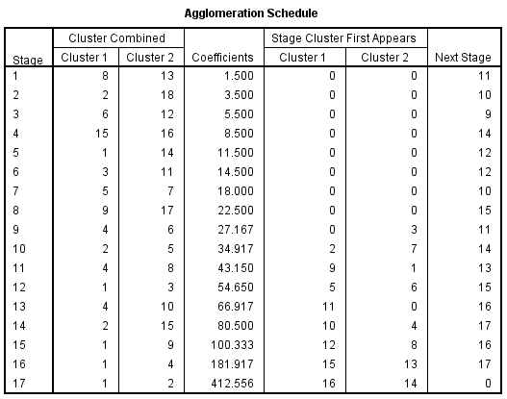
Example: Applying Ward’s method to the beverage data using SPSS (SPSS file Beverage.data.sav)
Click Analyze, Classify, Hierarchical Cluster
After selecting variables, click Method, Wards, Continue
Click Plots, and select Dendrogramand unselect Icicle Plot (click “none”)
Click Continue, Ok
Stage at which another cluster is combined with this one
Here, cluster can be single case or multicase.
Stage at which a multicase cluster is first formed
Coeff. is the distance measure. Want to look for large gap

Slide 14
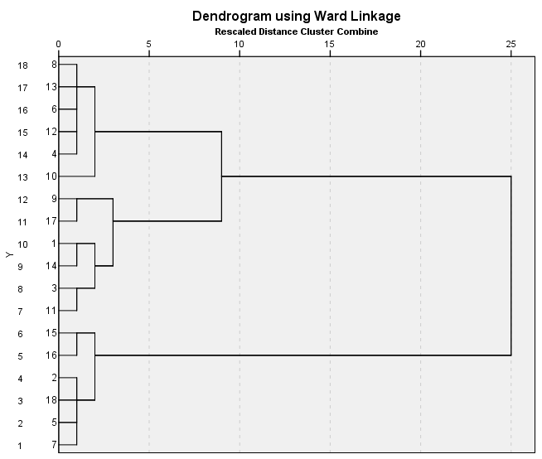

Slide 15
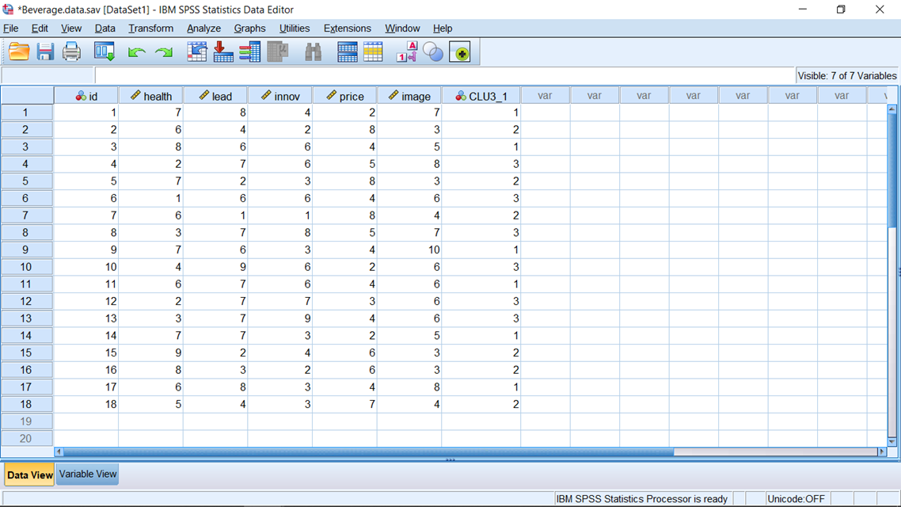
Selecting the 3 cluster solution, we can obtain cluster memberships by rerunning the cluster analysis after clicking Save, Single Solution, specify 3, click Continue and Ok. The 3 group membership identifier variable will be saved to your file. We can now run descriptive stats for the different groups and compare/interpret.

Slide 16
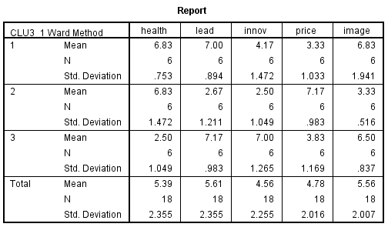
Running Compare Means using the cluster memberships

Slide 17
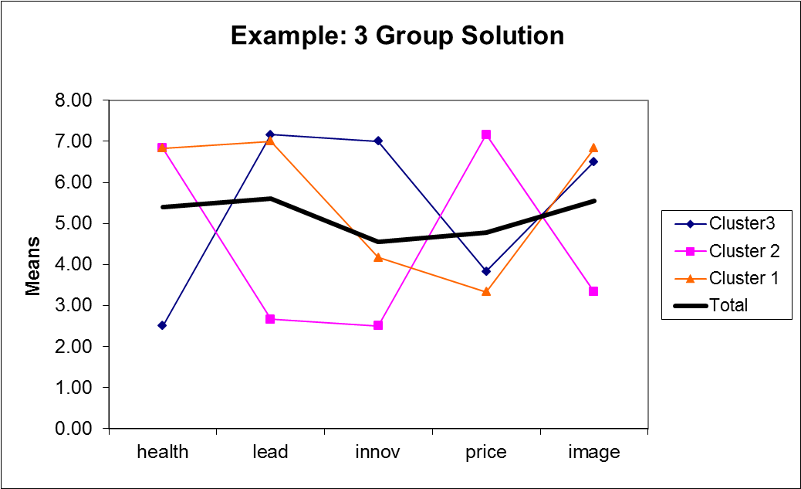
Note the differences in groups illustrated by descriptives. Practitioners often develop descriptive names for the clusters.

Slide 18
Added Application 1)
A company that produces chewing gum is interested in homogenous consumer groups based on attitudinal dimensions. Seven attitudinal questions were included in a questionnaire and consumers were asked to express their level of agreement on an 11 point scale (0=strongly disagree, 10=strongly agree)
I like to use gum to freshen my breath
I avoid gum that has sugar
Taste is the primary factor when I choose gum
I like to be considered a leader
I’m usually one of the first to try new things
I am very much aware of gum prices
I like to share gum with others
The resulting data is provided in the SPSS file CG.sav.
Using Ward’s method determine a cluster solution and interpret your results.

Slide 19
Note that with hierarchical procedures, there is no reallocation of cases at later stages of the process (no going back).
Nonhierarchical Clustering: K-Means Method
Basic Steps
1) Partition the cases/items into K initial clusters (this is often performed by an initial set of K seeds points which can be K actual cases selected from the data).
2) Assign items to the cluster with the nearest centroid (SPSS K-Means uses Euclidean distances from centroids). Update the centroids
3) Repeat step 2 until no reassignments take place.
Note that K-Means requires a prespecification of K, and also requires starting seeds. Final cluster solutions will be dependent upon the initial seed points.

Slide 20
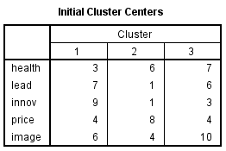
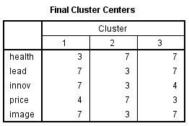
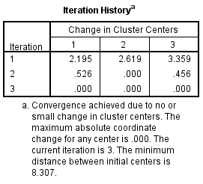
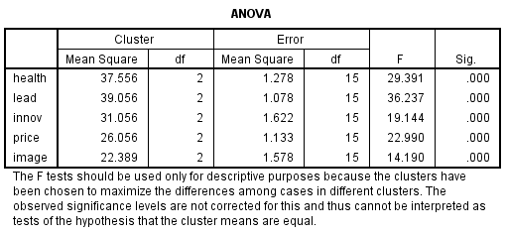
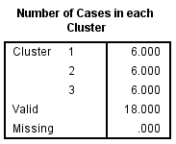
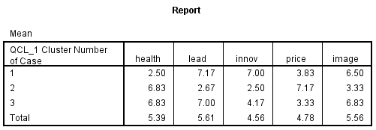
Applying K-means to the beverage data
Click Analyze, Classify, K-means cluster
After entering variables select 3 for Number of clusters
Click Options and select ANOVA table
Click Save and select Cluster membership, click Continue, then Ok
How could we compare this solution with our Wards Hierarchical sol. ?

Slide 21
The Tandem Approach: Combining Hierarchical and Non-Hierarchical methods
A methodology sometimes used in practice is to combine both approaches. First a hierarchical method (Ward’s is a common choice) is performed. Next K-means is performed using the centroids obtained from the non-hierarchical method as the initial seed points.

Slide 22
Interpretation and Validation
Cluster centroids are useful for interpretation, and deciding the appropriate number of clusters
In addition, it is often useful to profile the clusters by variables other than the basis variables– such as demographics, media usage, etc.
Validation can be performed by splitting the sample and determining cluster consistency.
K-Means solutions may depend on the order of the data file. Try multiple runs with different orderings and assess stability
Classification analysis (a topic we’ll cover soon) is a commonly used technique for assessing stability and scoring.

Slide 23
Data Issues
-Standardization
-Correlations among basis variables
Added Application 2)
Use K-means on the chewing gum data to obtain a cluster solution using the same number of clusters that you determined in Added Application 1. How do the two cluster solutions compare ?

Slide 24
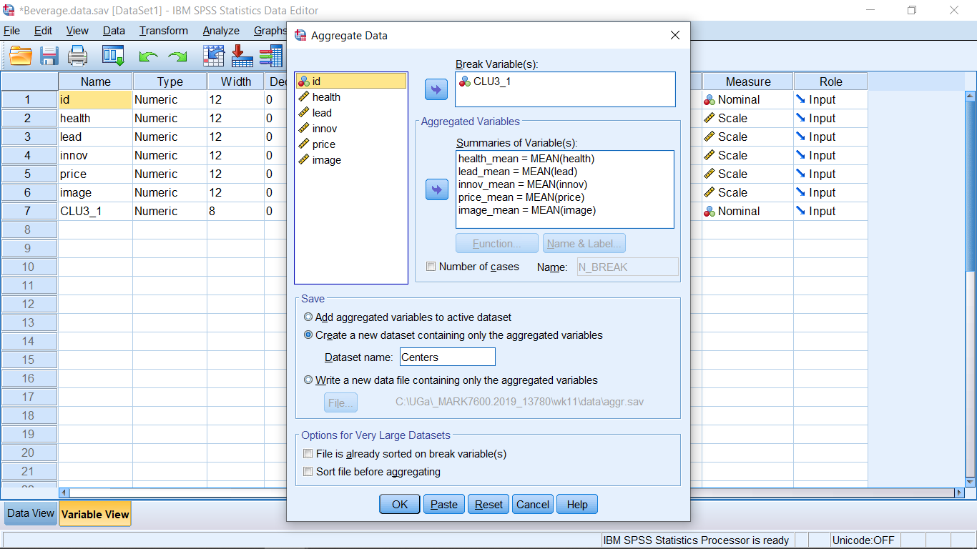
Appendix: Saving centers from hierarchical clustering and reading into K-Means as starting centers (Tandem approach)
Select Data > Aggregate and put the cluster membership variable in the Break Variable window, basis variables in the Summaries of variables window. Select Create a new data set… and provide a name.

Slide 25
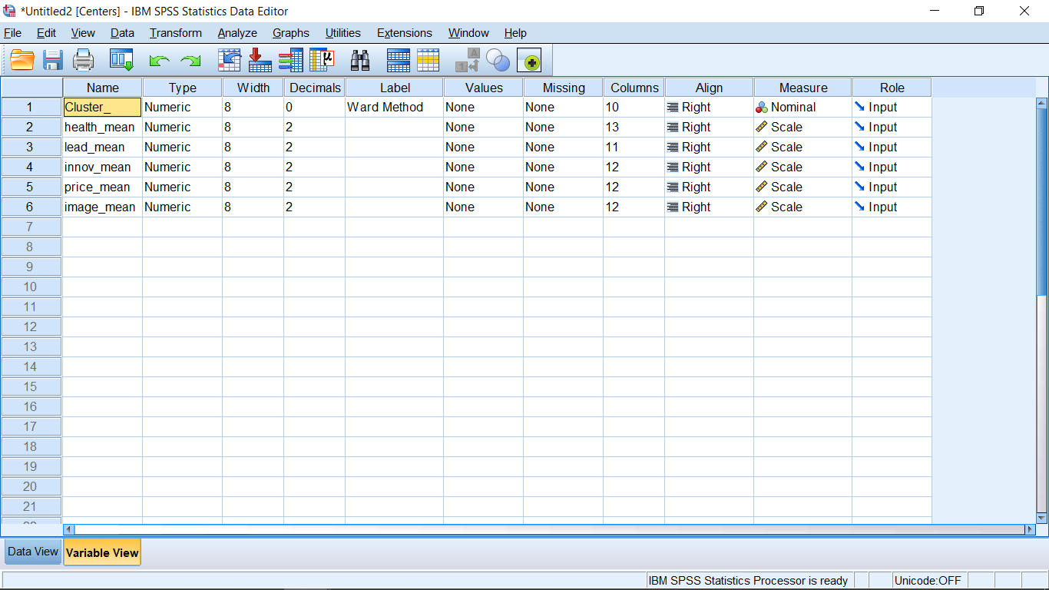
In the new file with the centers, change the name of the first variable to Cluster_ (SPSS system variable name)

Slide 26
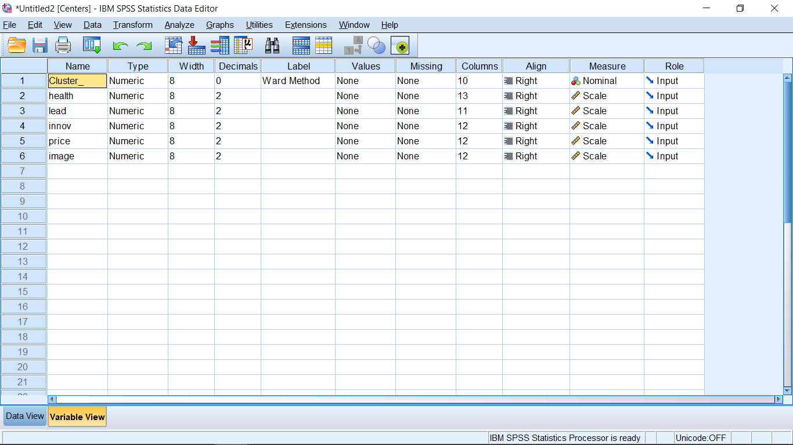
Delete the “_mean” part of the aggregated basis variable names.

Slide 27
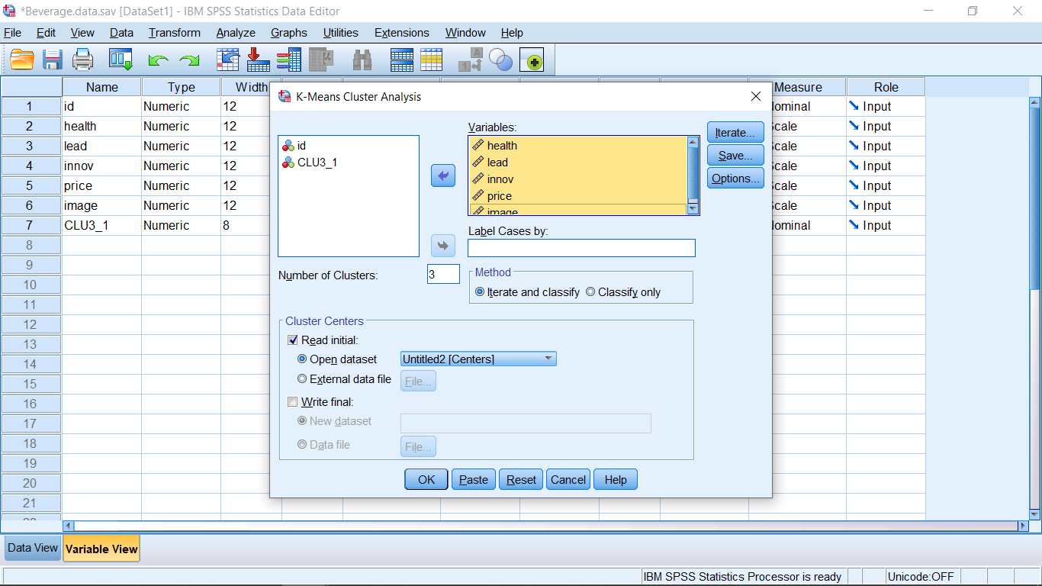
In the K-Means dialog window, select Read initial, Open dataset, OK

Slide 28
SAS Code for Cluster Analysis
Applying Ward’s method to the beverage data.
proc import datafile=“D:\BeverageData.sav" DBMS=SAV OUT=bev;
run;
proc cluster data=bev noeigen method=ward nonorm outtree=tree pseudo;
id id; /* copies id to the output file */
var health lead innov price image;
run;
/* proc tree creates output file with 3
cluster sol memberships. id specifies which var to use for identifying cases */
proc tree data=tree out=clus3 nclusters=3 noprint;
id id;
copy health lead innov price image;
run;
proc sort data=clus3;by cluster;run;
proc means data=clus3;by cluster;run; /*getting profile information for 3 group solution */

Slide 29
Tandem example using the centroids from Ward's procedure for 3 group solution as starting seeds for K-Means
proc sort data=clus3;by cluster;run;
proc means data=clus3 noprint;by cluster;
output out=initial mean=health lead innov price image;
var health lead innov price image;
run;
proc fastclus data=bev seed=initial maxc=3 out=fc3gpout maxiter=50;
var health lead innov price image;
id id;
run;
proc print data=fc3gpout(obs=5);run;

